Slide 1
Project1_SalesViz
Problem Statement :- Jadhav Store wants to analyse the Historical data
of Orders and get insights from it to improve business.

Slide 2
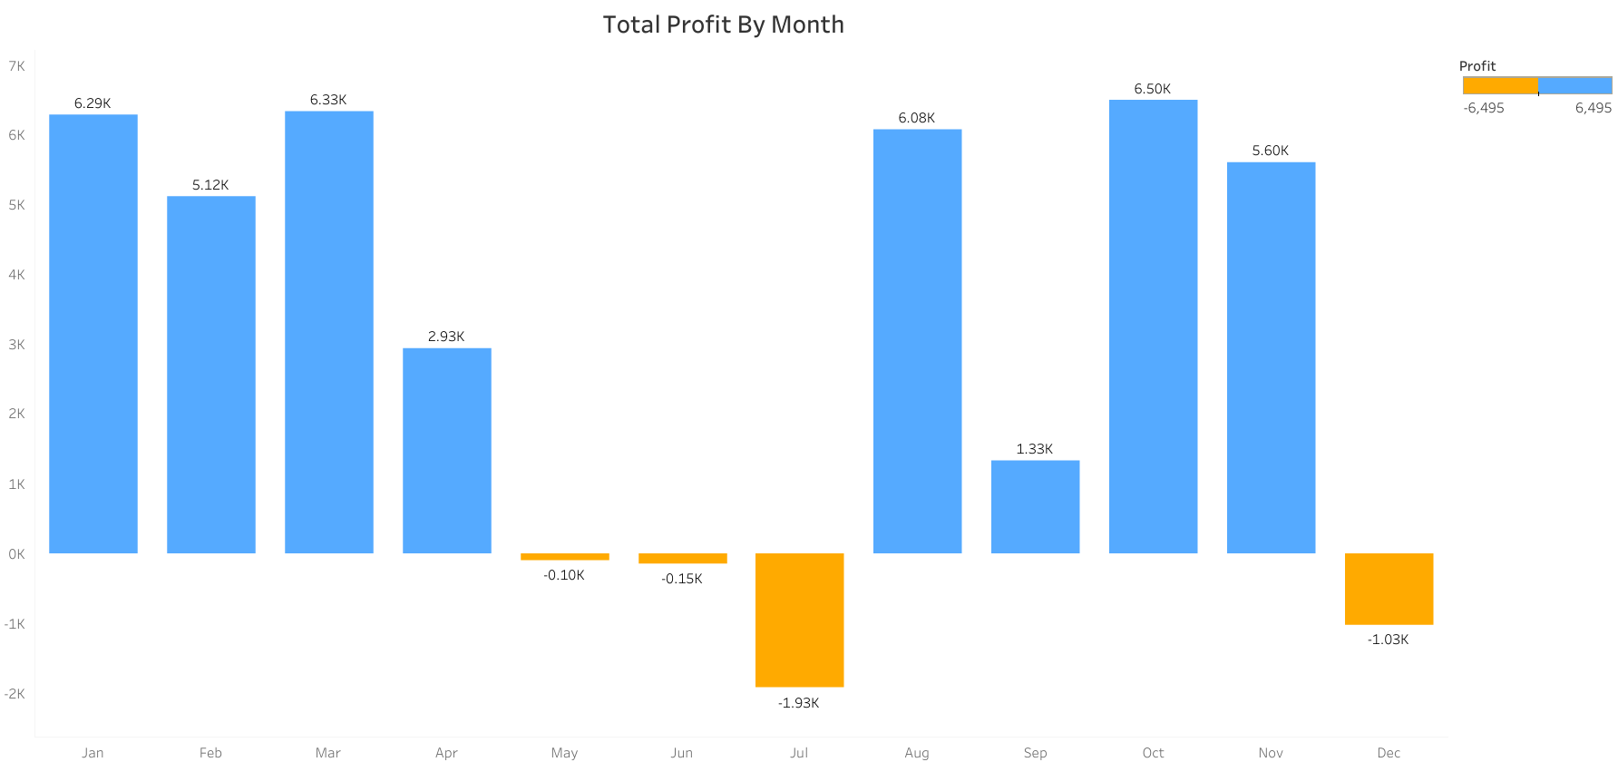
From above graphs, we can understand that in month of October company is getting maximum profit whereas company is facing loss in the month of May, June, July(max) and December.

Slide 3
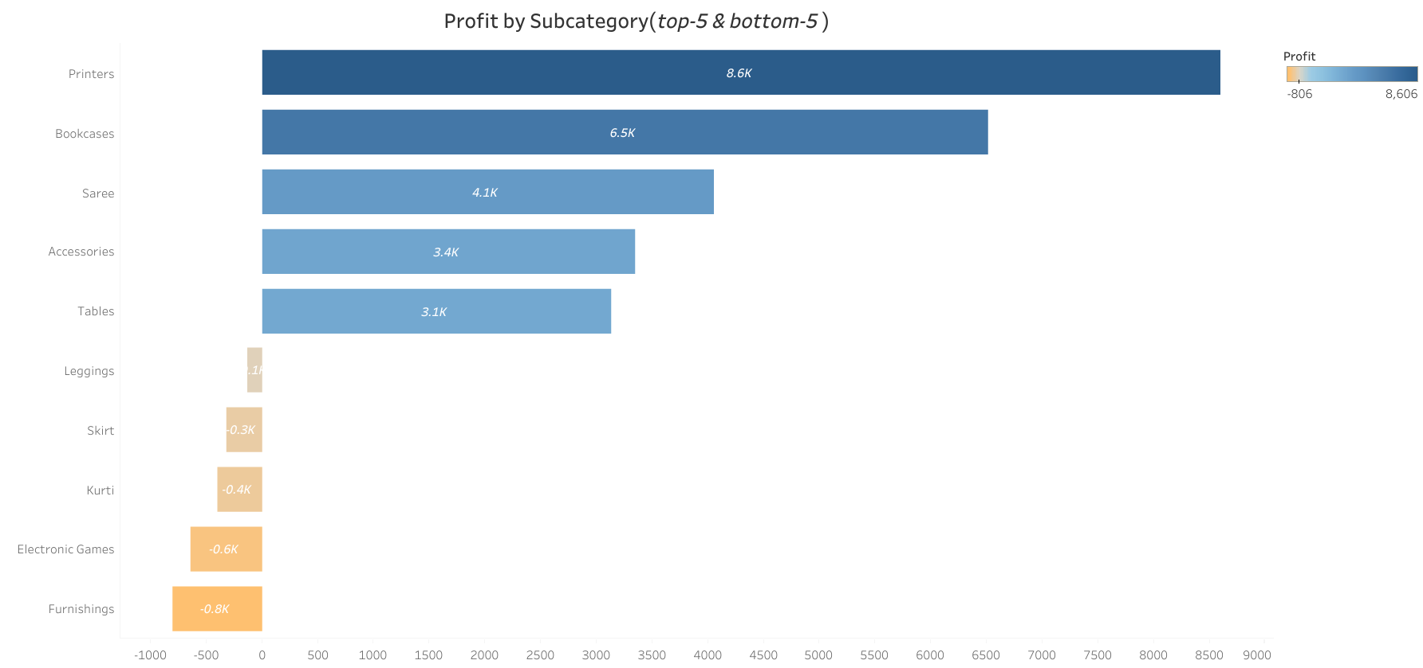
From above graph we can understand, Printers, Bookcases, Saree, Accessories and Tables are our most profit making subcategories so company should focus more on those categories.

Slide 4
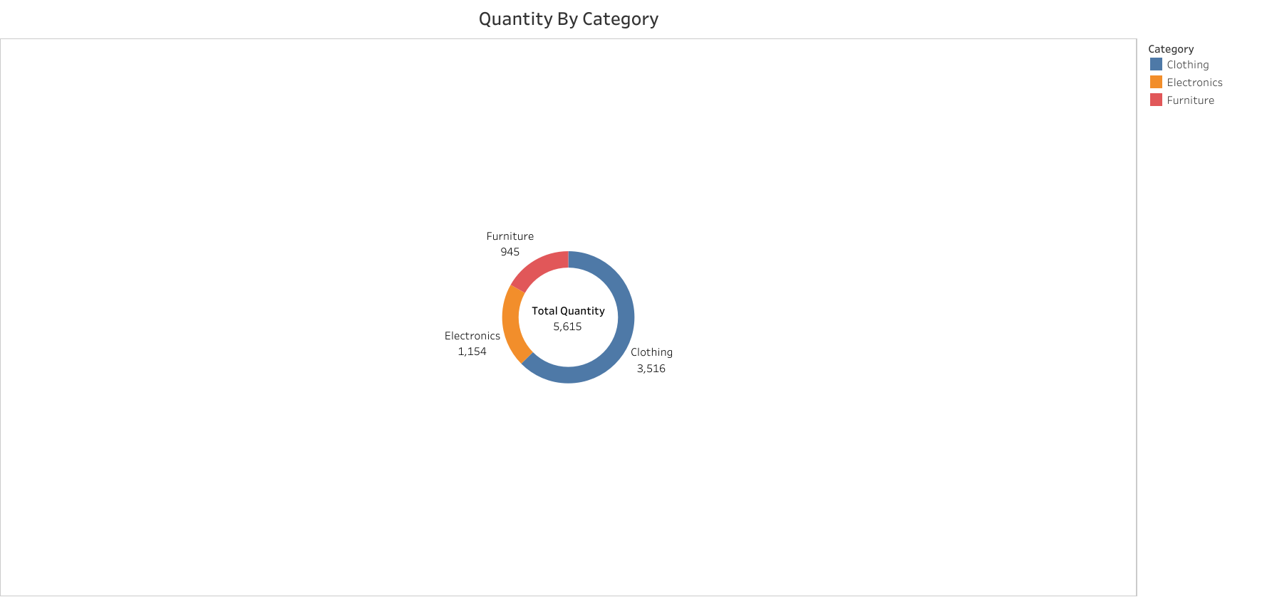
Above graph shows, If we go by category then Clothing quantity sold most whereas Furniture quantity sold least in the least.

Slide 5
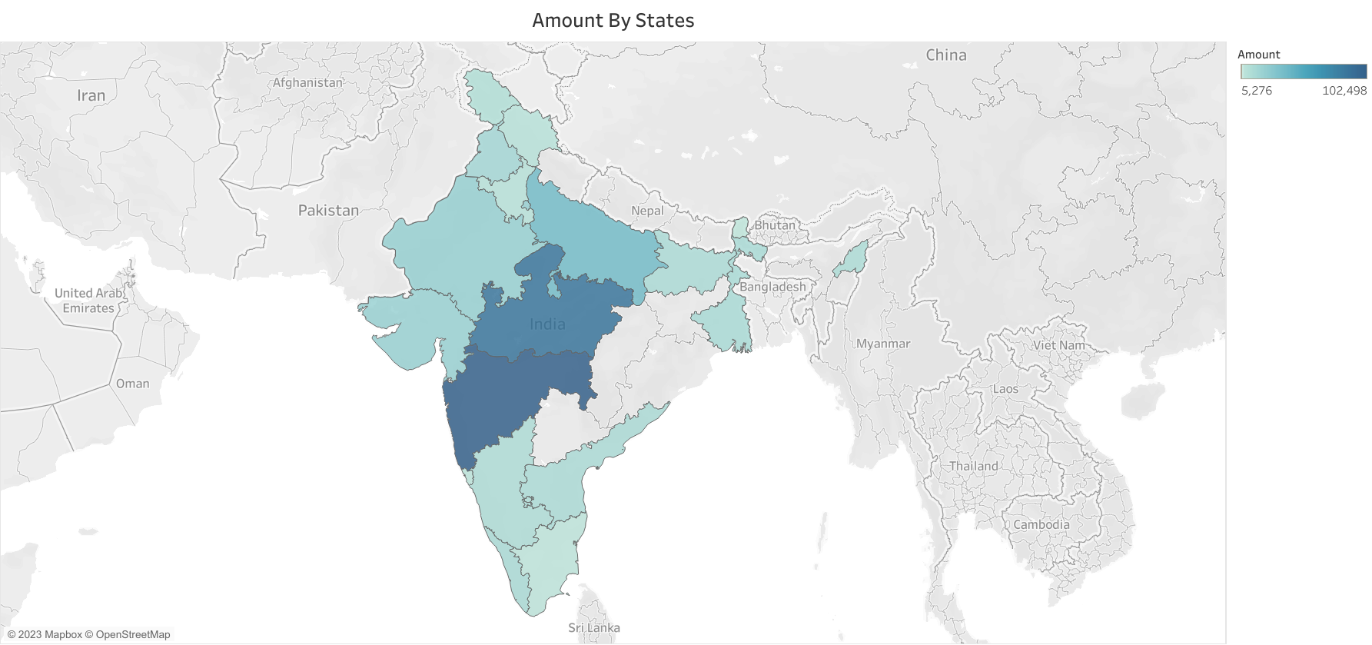
Above graph says, company’s most revue is coming from two states namely Maharashtra and Madhyapradesh whereas company is generating very less revenue from North-East sates as we as from southern most state

Slide 6
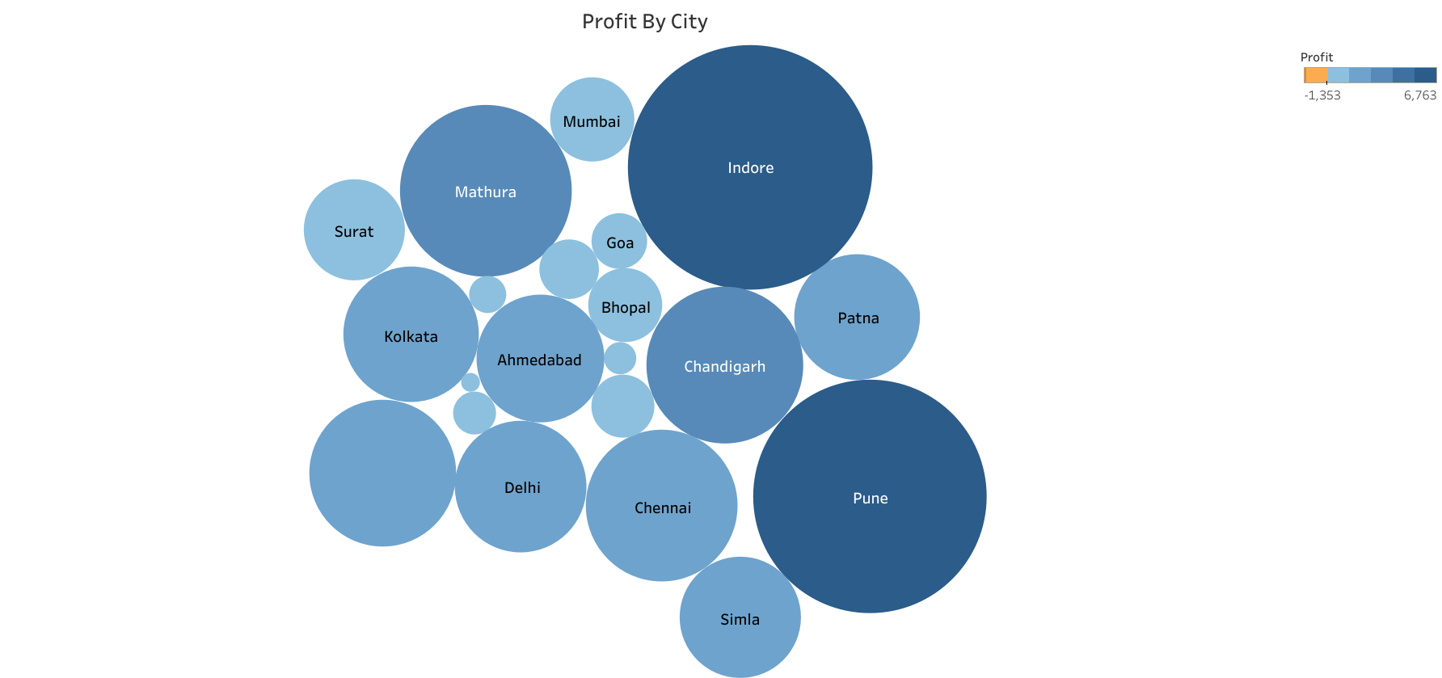
Above graph represent that, all over the country company getting more profit by doing business in cities like Indore Pune and Mathura subsequently.

Slide 7
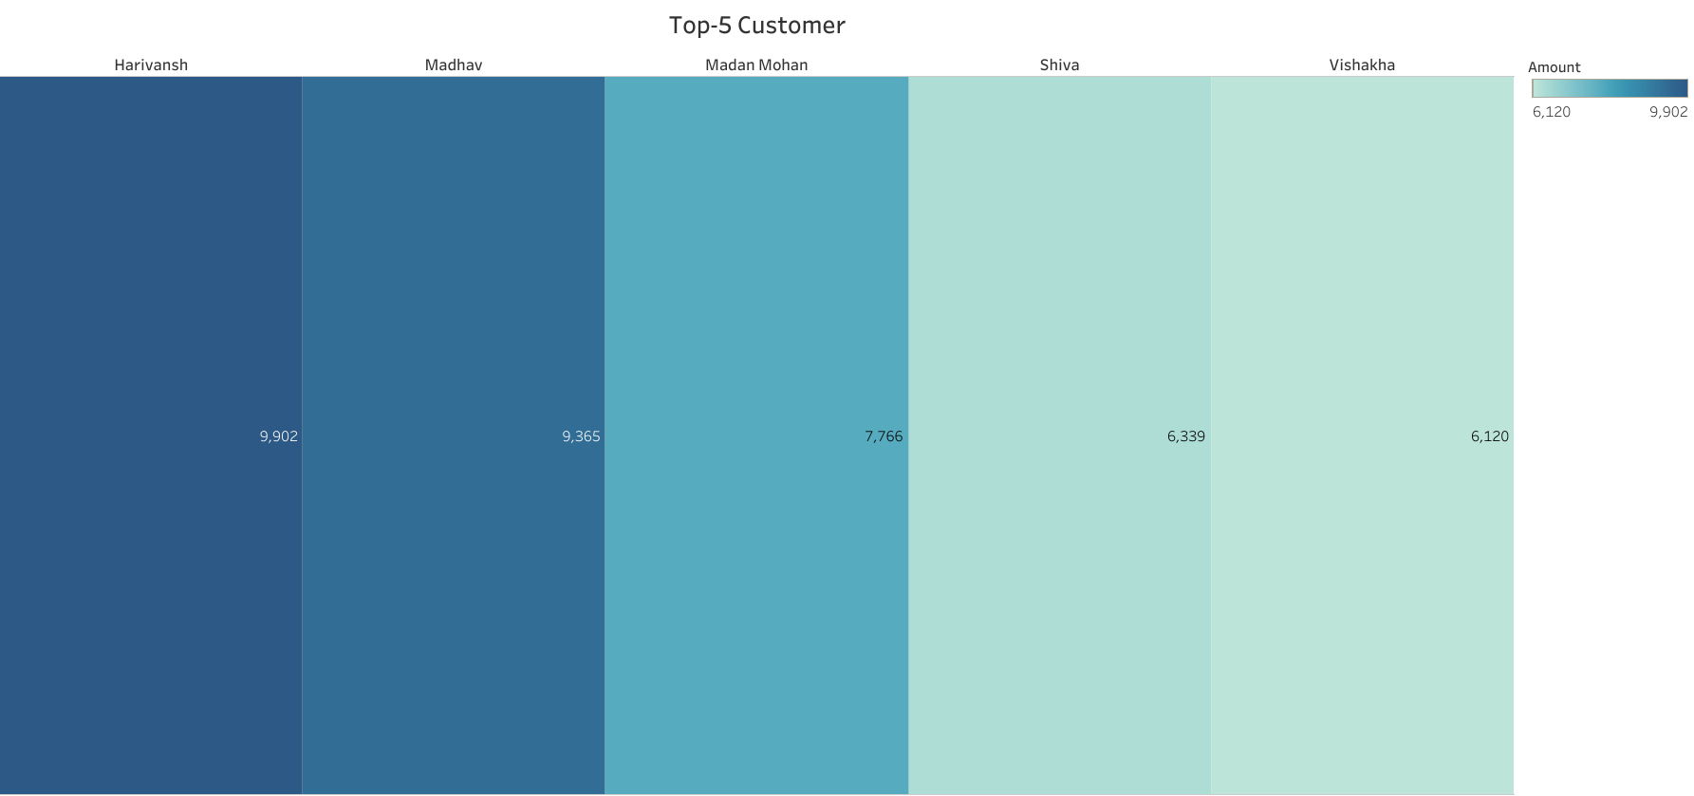
Above graph showing, Top-5 customer with their amount

Slide 8
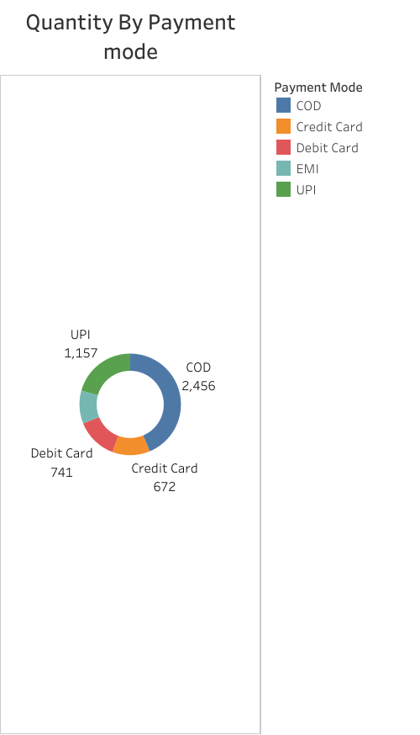
From above graph, we can say people are most likely to choose COD over online payment.

Slide 9
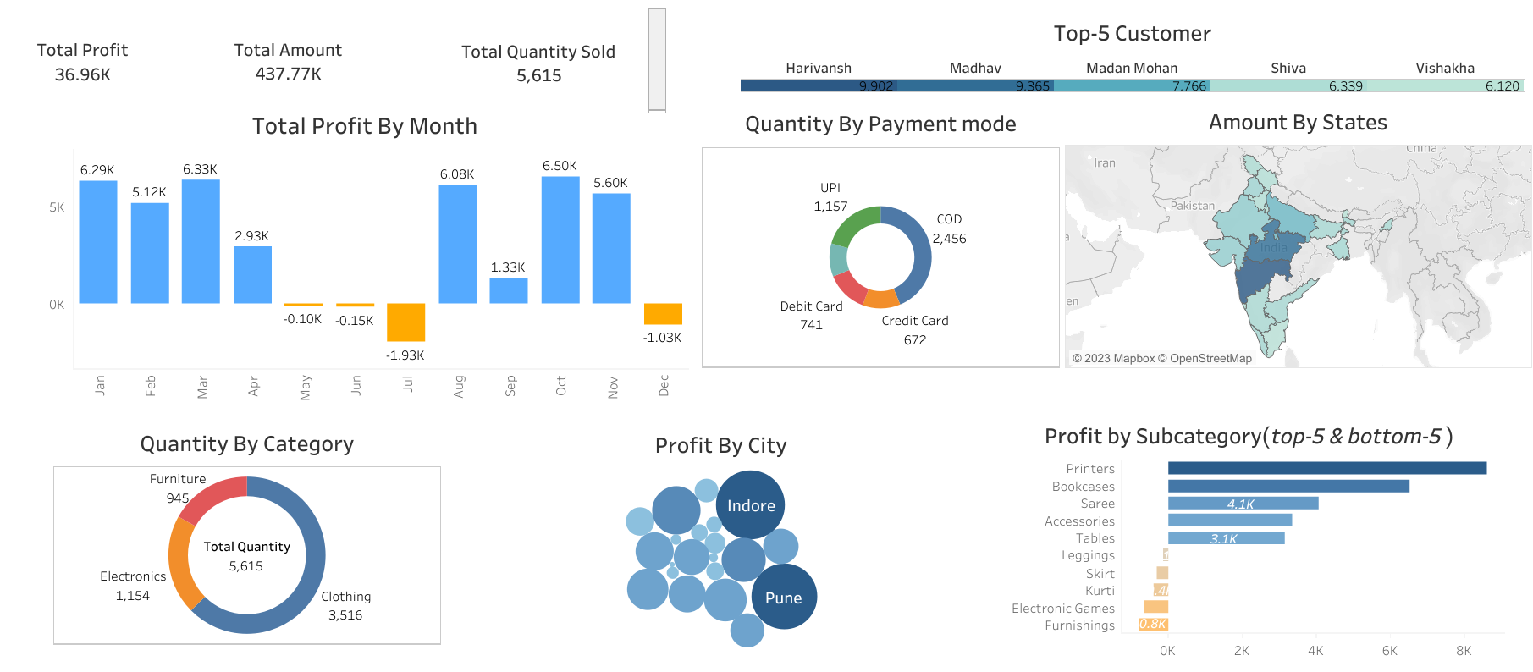
This is the image of interactive dashboard where you can click on any parameter and get data filtered by that parameter

